Slide 1
Alma Inventory Model Overview
Yoel Kortick
Senior Librarian

Slide 2

Agenda
Introduction
Physical Inventory
Electronic Inventory
Digital Inventory
The Institution Zone and the Community Zone

Slide 3
Introduction

Slide 4
Introduction
As a Unified resource management system (URM) Alma handles all types of inventory.
This differs from legacy systems whereby different types of materials are handled in separate systems and harvested together. These separate systems were often referred to as “silos”.

Slide 5
Introduction
There are three types of inventory in Alma:
  Physical
  Electronic
  Digital
These are often referred to as P, E and D

Slide 6
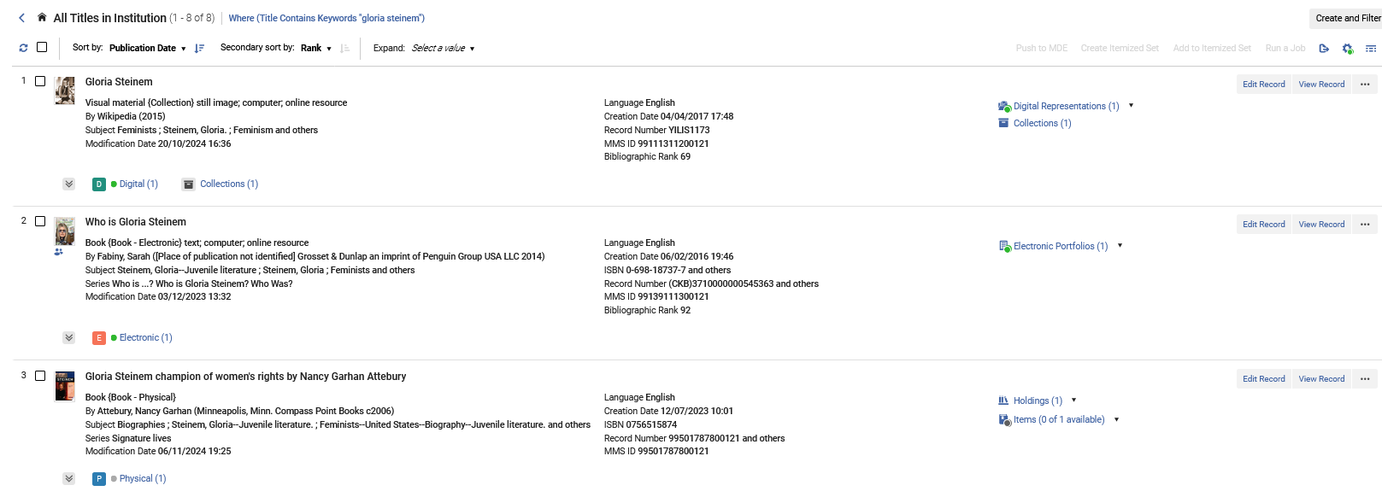
Introduction
Example from standalone institution (not a member of a Network Zone Consortium)
Linked to CZ

Slide 7
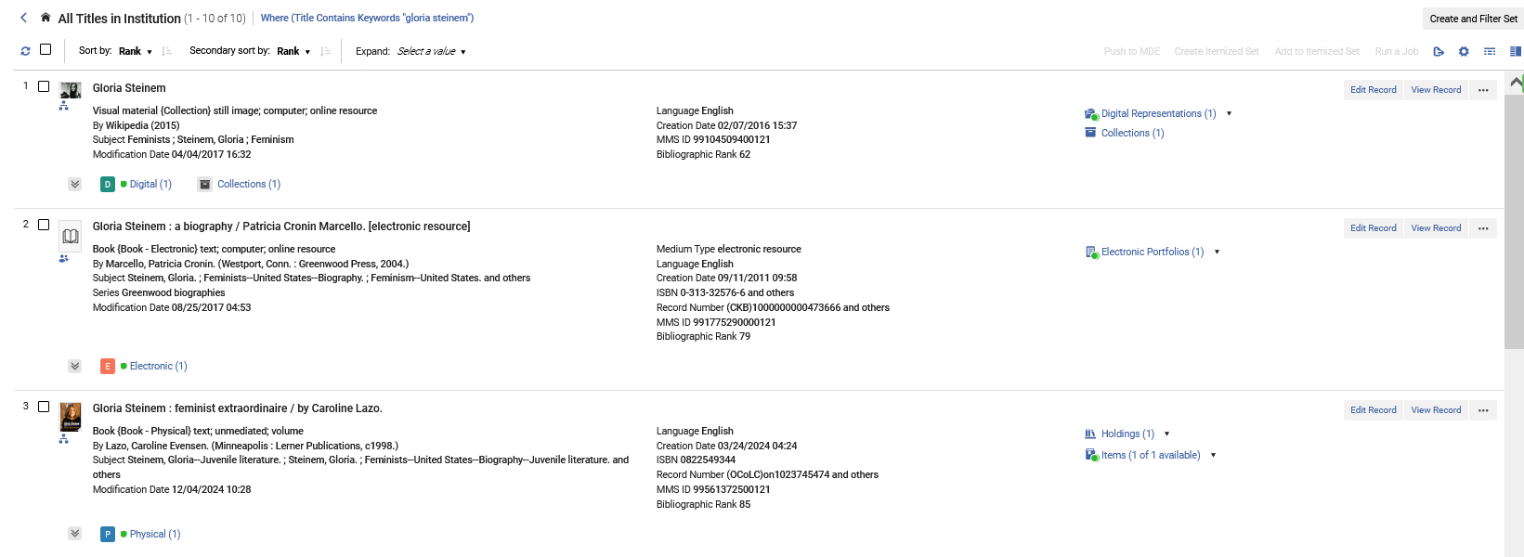
Introduction
Example from member institution of a Network Zone Consortium
Linked to NZ
Linked to CZ
Linked to NZ

Slide 8
Physical Inventory

Slide 9
Physical Inventory
In order to work with physical inventory a staff user must have one or more of the following roles:
  Physical Inventory Operator – required for adding and editing physical resources.
  Physical Inventory Operator Limited - Same as Physical Inventory Operator but cannot move inventory from one bibliographic record to the other.
  Physical Inventory Operator Extended – required for delete operations.
  Repository Manager – required for linking items to bibliographic records.

Slide 10
Physical Inventory
The roles related to physical inventory can be assigned to staff users on the level of the entire institution or on the level of a specific library or libraries. This is called the “Scope”
Thus, different users can be limited to working with inventory only in specific libraries

Slide 11
Physical Inventory
A user with this role can add and edit physical resources in the entire institution (which is called “Alma University)
A user with this role can add and edit physical resources in the Main Library
A user with this role can add and edit physical resources in the Library and Information Science Library

Slide 12
Physical Inventory
It is possible for one user to have the same role multiple times with different scopes.
For example, a user with these two roles can add and edit physical resources in both the Main Library and the Library and Information Science Library

Slide 13
Physical Inventory
Physical resources in Alma are organized in a three-tiered hierarchy:
Bibliographic record – The bibliographic record, which contains the metadata of the resource. (This is also true for digital and electronic resources.)
Holdings – The holdings act as a container for the physical items. Holdings records contain the following information: library, location, publication pattern (where applicable), classification, and notes. Holdings records are dependent on and linked to associated bibliographic records.
Items – inventory that corresponds to the actual physical items in the library. Item records contain the information that describes the physical record, such as shelf location. There can be multiple items under each holding. The item inherits information such as library and location.

Slide 14
Physical Inventory
We will see an example of this in the next slides
Bibliographic Record
Holdings Record
Holdings Record
Item
Item
Item

Slide 15

Physical Inventory
This is bibliographic record MMSID 99133011000121 Title “Gloria Steinem : feminist extraordinaire”.

Slide 16
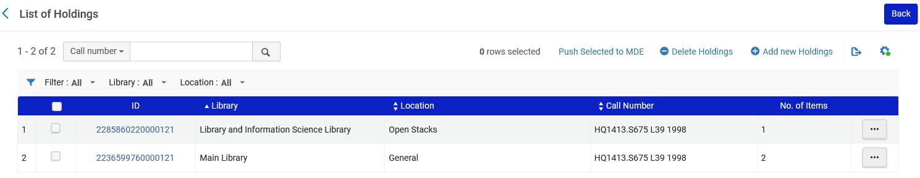
Physical Inventory
The bibliographic record has two holdings records

Slide 17
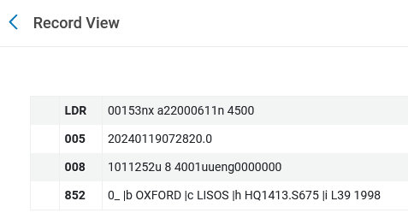
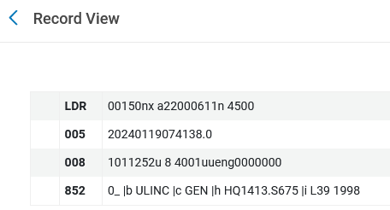
Physical Inventory
The bibliographic record has two holdings records
Library and Information Science Library
Open Stacks Location
Classification
Main Library
General Location
Classification

Slide 18
Physical Inventory
There is one physical item in the “Library and Information Science Library” “Open Stacks” Location, with classification “HQ1413.S675 L39 1998”
There are two physical items in the “Main Library” “General” Location, with classification “HQ1413.S675 L39 1998”

Slide 19
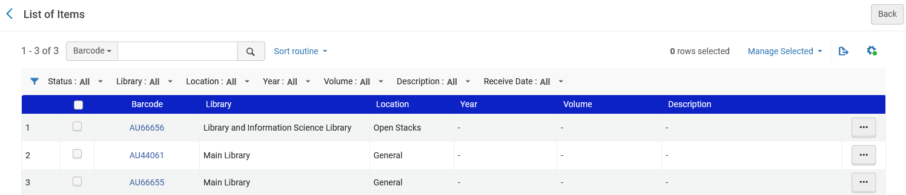
Physical Inventory
There is one physical item in the “Library and Information Science Library” “Open Stacks” Location, with classification “HQ1413.S675 L39 1998”
There are two physical item in the “Main Library” “General” Location, with classification “HQ1413.S675 L39 1998”
Associated with the holdings record for “Library and Information Science Library”
Associated with the holdings record for “Main Library”

Slide 20
Electronic Inventory

Slide 21
Electronic Inventory
In order to work with Electronic inventory a staff user must have one or more of the following roles:
  Electronic Inventory Operator OR Repository Manager – required to activate e-resources
  Electronic Inventory Operator Extended (required for delete operations)
  CDI Inventory Operator – required to work with the Central Discovery Index (CDI).

Slide 22
Electronic Inventory
The roles related to electronic inventory can be assigned to staff users on the level of the entire institution or on the level of a specific library or libraries. This is called the “scope”.

Slide 23
Electronic Inventory
A user with this role can add only library “Main Library” in the “Library” field of the electronic portfolio in the electronic portfolio editor
A user with this role can add only library “Library and Information Science Library” in the “Library” field of the electronic portfolio in the electronic portfolio editor

Slide 24
Electronic Inventory
It is possible for one user to have the same role multiple times with different scopes.
A user with both of these roles can add library “Main Library” or library “Library and Information Science Library” in the “Library” field of the electronic portfolio in the electronic portfolio editor

Slide 25
Electronic Inventory
A user with this role can add any library in the “Library” field of the electronic portfolio in the electronic portfolio editor. “Alma University” is the name of the institution.

Slide 26
Electronic Inventory
Electronic resources in Alma are organized in a three-tiered hierarchy:
Electronic Collection – A collection of electronic resources that is either a package of electronic portfolios (i.e. aggregator package or selective package) or a database (which does not include portfolios or full text service and whose resources cannot be individually managed through an interface).
Electronic Services – The type of access to the e-resource (which typically is “full-text”) and connection/linking information.
Electronic Portfolios – Titles that can be standalone entities or be part of an electronic collection. Electronic portfolios maintain the specific coverage (local or global), services, and link information relevant for a particular electronic title.

Slide 27
Electronic Inventory
Bibliographic record
We will see an example of this in the next slides
Electronic Collection
Electronic Service
(Full Text)
Bibliographic record
Bibliographic record
Bibliographic record
Bibliographic record
Electronic Portfolio
Electronic Portfolio
Electronic Portfolio
Electronic Portfolio

Slide 28
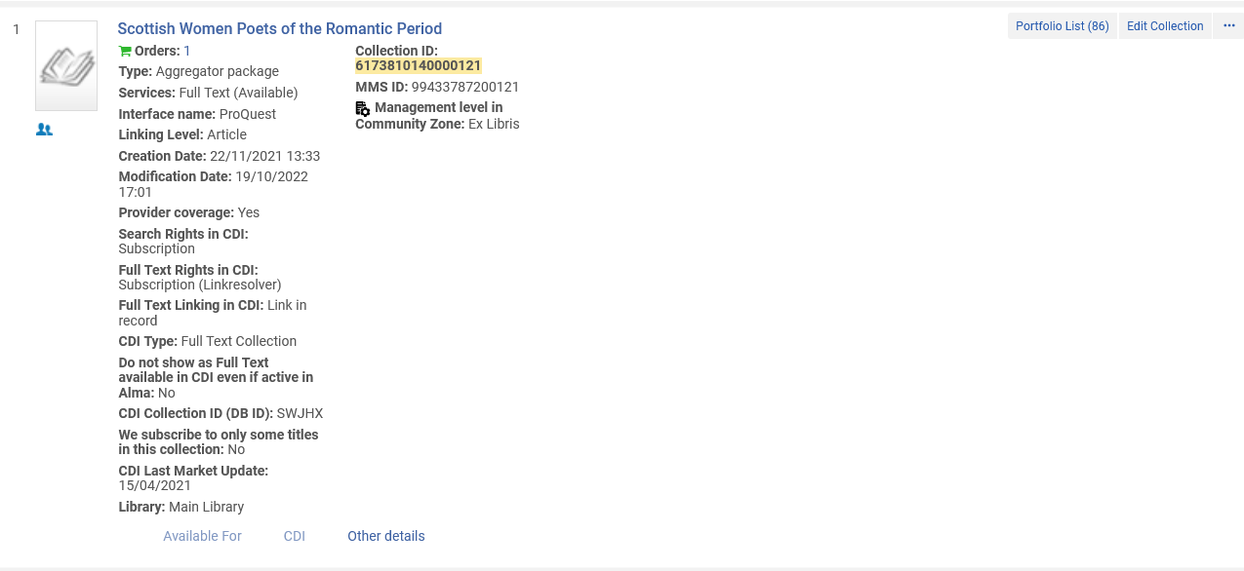
Electronic Inventory
This is electronic collection ID 6173810140000121 Title “Scottish Women Poets of the Romantic Period”.

Slide 29
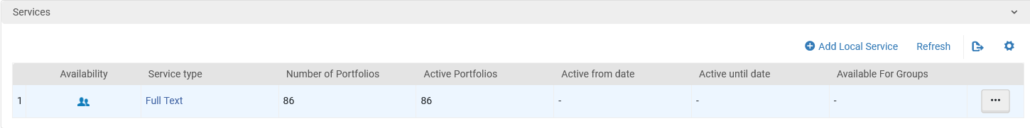
Electronic Inventory
The electronic collection has a full text service

Slide 30
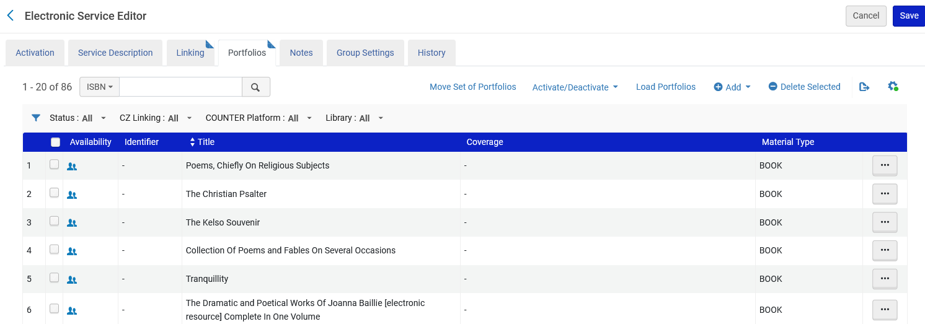
Electronic Inventory
The electronic service has 86 portfolios

Slide 31
Digital Inventory

Slide 32
Digital Inventory
In order to work with Digital inventory a staff user must have one or more of the following roles:
  Digital Inventory Operator – required for adding and editing digital representations
  Digital Inventory Operator Extended – required for delete operations
  Collection Inventory Operator – required when adding a new digital representation

Slide 33
Digital Inventory
The roles related to digital inventory can be assigned to staff users on the level of the entire institution or on the level of a specific library or libraries. This is called the “scope”.

Slide 34
Digital Inventory
A user with this role can add only library “Main Library” in the “Library” field of the digital representation in the Digital Representation Resource Editor
A user with this role can add only library “Library and Information Science Library” in the “Library” field of the digital representation in the Digital Representation Resource Editor

Slide 35
Digital Inventory
It is possible for one user to have the same role multiple times with different scopes.
A user with both of these roles can add library “Main Library” or library “Library and Information Science Library” in the “Library” field of the digital representation in the Digital Representation Resource Editor

Slide 36
Digital Inventory
A user with this role can add any library in the “Library” field of the digital representation in the Digital Representation Resource Editor. “Alma University” is the name of the institution.

Slide 37
Digital Inventory
Digital resources in Alma are organized in a three-tiered hierarchy:
Bibliographic record – The top level consists of the bibliographic record, which contains the metadata of the resource.
Representation – The middle level is the representation level. This level acts as a container for the digital files. Multiple representations can be attached to the bibliographic record.
File – The third level is the file level. There can be several files in each representation.

Slide 38
Digital Inventory
We will see an example of this in the next slides
Bibliographic Record
Digital Representation
File
File
File
File

Slide 39
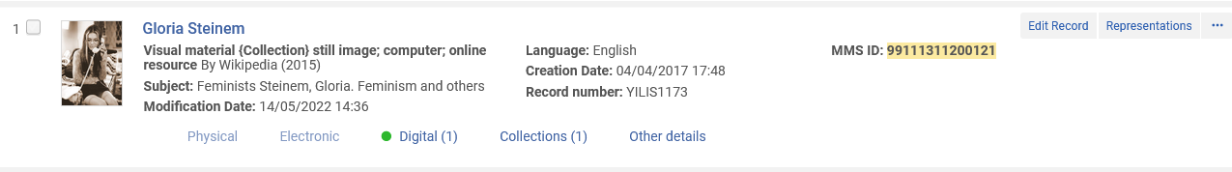
Digital Inventory
This is bibliographic record MMSID 99111311200121 Title “Gloria Steinem”.

Slide 40
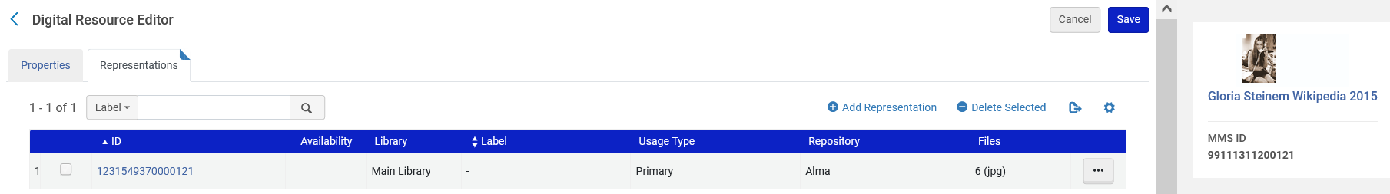
Digital Inventory
The bibliographic record has one Digital Representation

Slide 41
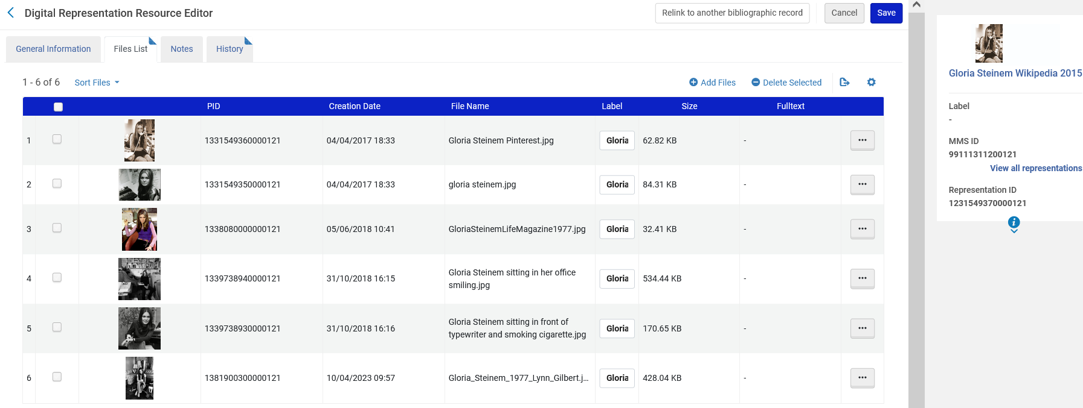
Digital Inventory
The Digital Representation has 6 files

Slide 42
The Institution Zone and the Community Zone

Slide 43
The Institution Zone and the Community Zone
Alma includes an Institution Zone and a Community Zone.
In the case of a Network Zone Consortium there is also a Network Zone.
Everything in this presentation regarding the Institution Zone and the Community Zone is also relevant for a Network Zone Consortium.

Slide 44
The Institution Zone and the Community Zone
Community Zone
Institution Zone
Global Authorities
(MMS)
Shared repository of standard authority files
Institution Catalog
(MMS)
Metadata repository managed by the institution
MARC or Dublin Core formats
Optionally includes local authority records
Community Catalog
(MMS)
Shared metadata repository
Institution Inventory
Physical, electronic and digital resources
Represents the sum of all resources managed by the institution and made available to the users.
May link to the Institution Catalog or to the Community Catalog
Central KnowledgeBase
(Inventory)
Shared administrative information for electronic collections and portfolios

Slide 45
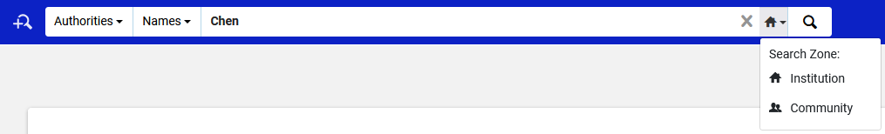
The Institution Zone and the Community Zone
Here for example, we can search authorities in the Institution Zone or the Community Zone.
The authorities in the Institution Zone are local authorities

Slide 46
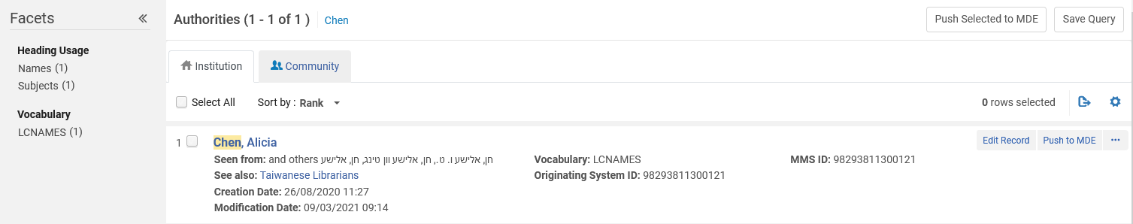
The Institution Zone and the Community Zone
This is a local authority

Slide 47
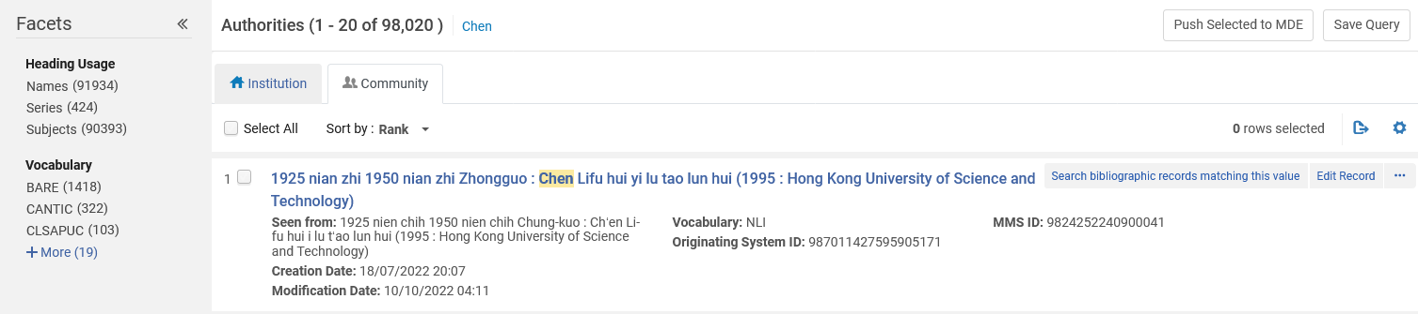
The Institution Zone and the Community Zone
This is a global authority

Slide 48
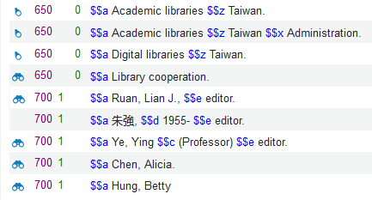
The Institution Zone and the Community Zone
Headings in bibliographic records can be linked to local or global authorities

Slide 49
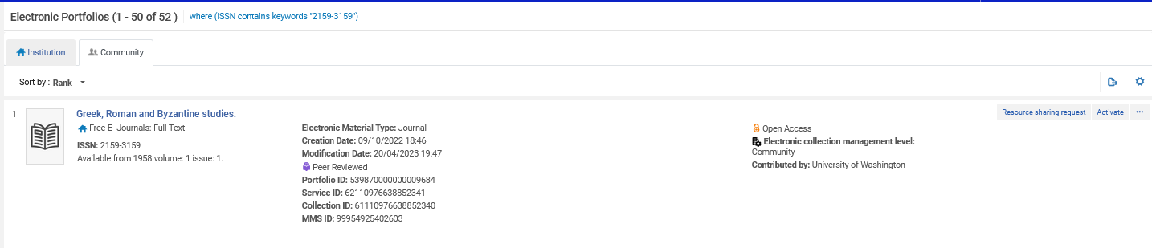
The Institution Zone and the Community Zone
The Community Zone is a shared catalog and metadata repository
This is an electronic portfolio which was contributed to the Community Zone by University of Washington

Slide 50
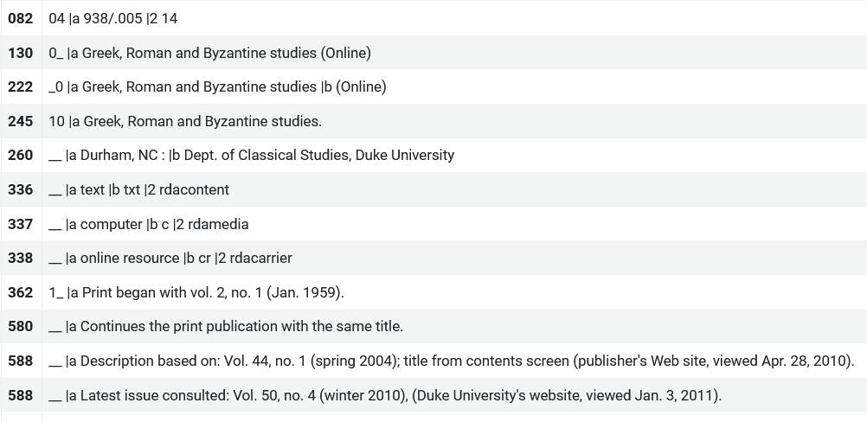
The Institution Zone and the Community Zone
The Community Zone is a shared catalog and metadata repository
Here is part of the metadata contributed by University of Washington

Slide 51
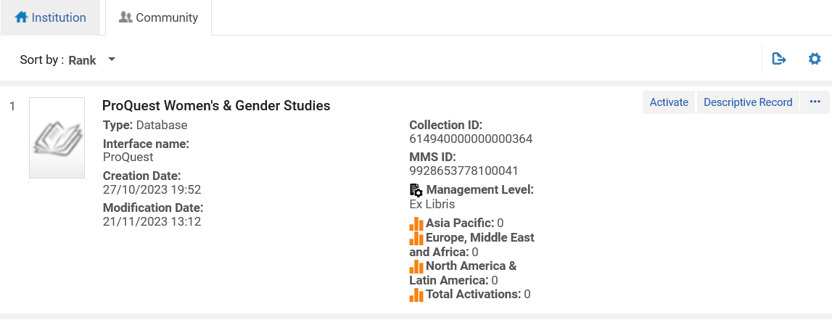
The Institution Zone and the Community Zone
The Community Zone includes a Central KnowledgeBase (CKB) which includes shared administrative information for electronic collections and portfolios

Slide 52
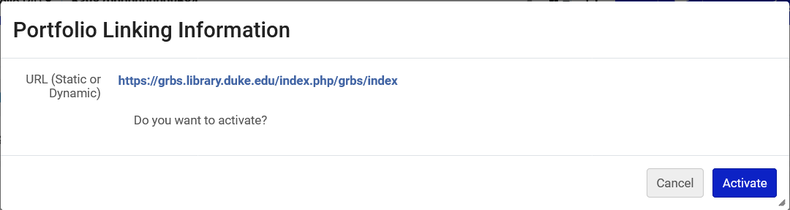
The Institution Zone and the Community Zone
The Community Zone includes a Central KnowledgeBase (CKB) which includes shared administrative information for electronic collections and portfolios
This is the linking information and an option to activate from the Community Zone for portfolio “Greek, Roman and Byzantine studies”.

Slide 53
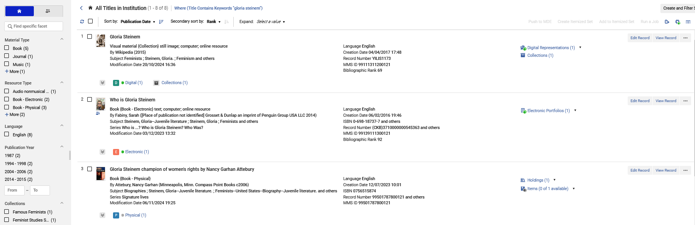
The Institution Zone and the Community Zone
The institution zone is a metadata repository managed by the institution
The Institution Zone contains physical, electronic and digital resources

